Slide 1
INFLUENZA PANDEMIC BRIEFING
Novel H1N1 Influenza

Slide 2


Slide 3
What You Need to Know
Flu season never ended in VA (although better). Implications for schools as they begin their new academic year
Preparedness status - you, your family and your agency
Novel H1N1 virus vaccination and mitigation planning
Resources

Slide 4
Goals
Brief update of current status/knowledge of H1N1 flu
Clarify current planning needs/gap focus areas
Identify key questions relevant to this pandemic
Engage your involvement in pan flu COOP

Slide 5
Virginia’s Response
Surveillance
Communication
Prevention/Vaccination
Mitigation
Medical Care/Surge

Slide 6
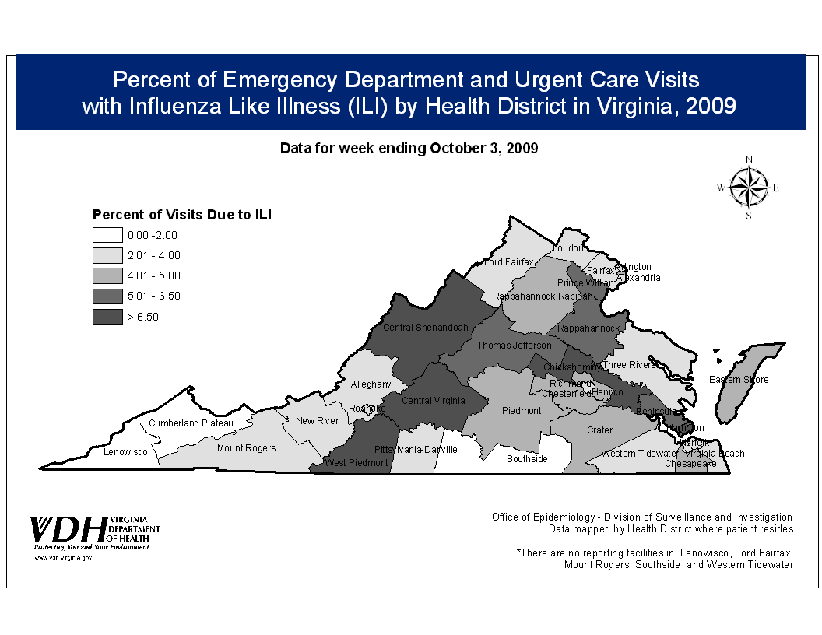

Slide 11
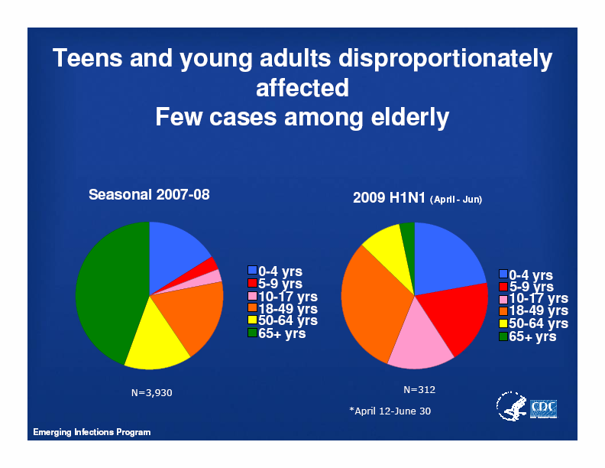

Slide 12
H1N1 2009 influenza virus infection during pregnancy in the USA
The Lancet, Volume 374, Issue 9688, Pages 451 - 458,
8 August 2009
Findings
From April 15 to May 18, 2009, 34 confirmed or probable cases of pandemic H1N1 in pregnant women were reported to CDC from 13 states. 11 (32%) women were admitted to hospital. The estimated rate of admission for pandemic H1N1 influenza virus infection in pregnant women during the first month of the outbreak was higher than it was in the general population (0·32 per 100 000 pregnant women, 95% CI 0·13—0·52 vs 0·076 per 100 000 population at risk, 95% CI 0·07—0·09). Between April 15 and June 16, 2009, six deaths in pregnant women were reported to the CDC; all were in women who had developed pneumonia and subsequent acute respiratory distress syndrome requiring mechanical ventilation.
Interpretation
Pregnant women might be at increased risk for complications from pandemic H1N1 virus infection. These data lend support to the present recommendation to promptly treat pregnant women with H1N1 influenza virus infection with anti-influenza drugs.

Slide 13
Virginia’s Response
Surveillance
Communication
Prevention/Vaccination
Mitigation
Medical Care/Surge

Slide 14
Communications The Foundation of Preparedness and Response
Multimodal effort to provide the public and key stakeholders with credible, critical, relevant, timely information
Public Inquiry Center: 1-877-275-8343
Website
Media Blitz
Focused Communications
Local Educators
Speakers Bureau

Slide 15
OUTREACH
Robust Media Campaign
Focused Communication to Select Groups
Business
Schools, Higher Ed
State Employees
Speakers’ Bureau
Clinician (specialized) ConfCalls / Mail
PanFlu Advisory Group
Medical Society Partnerships
Inquiry Center

Slide 17
National Preparedness
Community
Preparedness
Business and Organizational Preparedness
Individual and Family Preparedness

Slide 18
CDC Vaccination Priority Groups
Pregnant women
Those who live with or care for children younger than 6 months of age
Health care and emergency services personnel
Those 6 months - 24 years of age
Those 25 through 64 years with chronic health disorders or compromised immune systems.
“The groups listed above total approximately 159 million people in the United States”

Slide 19
VDH Influenza Vaccination Plan
Promote seasonal flu vaccination early
Public/private partnership to get H1N1 vaccine to “usual” vaccinators in the community
Public Health Vaccination Campaign
School-based vaccination
18-24 yo focused vaccination events
Track via state’s immunization registry
Mass Vaccination “Drills”

Slide 20
Components of Mitigation
Education
Isolation
Treatment
Antiviral Distribution
Quarantine
IMprobable for this pandemic
Social Distancing
School Closure
Event Cancellation

Slide 21
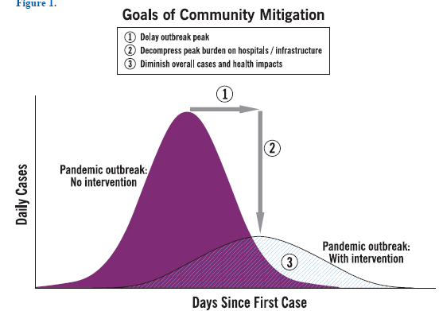

Slide 22
PANDEMIC SEVERITY INDEX

Slide 24
Medical Care/Surge
Info Exchange / Outreach
Pre event Healthcare Preparedness
Regional Coordinating Hospitals
Bed Tracking
Peds focus
Resource Management
Vaccine
PPE
Antivirals
Triage
Alternate Care Centers

Slide 25
Workplace Planning
Verify work-at-home capabilities
Exercise regularly
Consider provisioning multiple access methods for critical staff (broadband, DSL, air cards, etc.)
Prepare for psychological aspects
Prepare for labor shortage
Develop pools of available staff
Refresh/train pools regularly or at trigger point
Remain flexible/adaptable
Cohorting of sick children/day care

Slide 26
PanFlu COOP
Delegation of Authority
Leadership Succession
Cross Training
Discuss expectations with staff early
Communications will be key
Need reliable, credible sources of information
Need coordinated communication channels
Rely on both internal/external channels

Slide 27
Resources
Virginia Department of Health Website
www.vdh.virginia.gov
VDH Inquiry Center
1-877-275-8343
CDC H1N1 Website
www.cdc.gov/h1n1flu
DHHS Flu center:
http://www.flu.gov

